Slide 1
EXPLORATORY DATA ANALYSIS
New York City
Airbnb Listings
What 48,895 listings say about how New York prices a bed for the night.
48,895
5
221
16
listings
boroughs
neighbourhoods
columns
Khalid Al Dosari · Tuwaiq Bootcamp · EDA Project
Notes:
Good morning. I analysed the New York City Airbnb open dataset — 48,895 listings across the five boroughs, snapshot from 2019. My question was simple: what actually drives the price of a listing? Over the next few minutes I'll walk through the data quality problems I had to fix first, then what the cleaned data showed.

Slide 2
What's in the data
One row is one active listing, described by its host, its location, its price and its review history.
48,895
16
20.3%
8 Jul 2019
rows before cleaning
columns per listing
listings never reviewed
most recent review
Numerical features
Categorical features
price, minimum_nights, number_of_reviews
reviews_per_month, calculated_host_listings_count
availability_365, latitude, longitude
id and host_id are identifiers, not measurements
neighbourhood_group — the 5 boroughs
neighbourhood — 221 values, highly imbalanced
room_type — Entire home/apt, Private, Shared
host_name — free text, needed case cleaning
No target variable
Not categorical
This is an unlabelled market dataset. If it were modelled, price would be the natural target.
name is free text — 47,720 unique values. last_review is a date, stored wrongly as text.
Notes:
Each row is one listing. Ten numeric columns, but two of them — id and host_id — are identifiers, so they carry no measurement meaning. There's no target variable; this is an unlabelled market snapshot, and price is the column you'd predict if you modelled it. Worth flagging early: one in five listings has never been reviewed, and the most recent review in the file is 8 July 2019.

Slide 3
Six problems before any analysis
Nothing here is trustworthy until each of these is found, understood and justified.
1
Missing values
2
Hidden duplicates
3
Wrong data type
9,901 listings have no last_review and no reviews_per_month — 20.3%. name and host_name are missing a handful each.
duplicated() returned 0. But matching on host, rounded coordinates, room type, price and reviews exposed 217 near-duplicates.
last_review was stored as text, so it could not be compared, sorted or ranged as a date.
4
Invalid values
5
Inconsistent categories
6
Outliers
11 listings priced at $0. A free listing is not a real offer.
host_name held 11,453 spellings that collapsed to 11,429 once case and whitespace were normalised.
minimum_nights reaching 1,250 nights; prices up to $10,000; one host with 327 listings.
Notes:
Six distinct problems. The one I want to draw attention to is number two. Pandas' duplicated() returned zero, which makes the data look clean. It isn't — it just means no two rows are identical across all sixteen columns. When I defined a duplicate the way the business would, same host at the same coordinates offering the same room at the same price, 217 of them appeared.

Slide 4
Every fix, and why
The decision matters more than the method — each one is a judgement about what the data means.
Missing reviews
reviews_per_month → 0
No reviews means the rate genuinely is zero. last_review left missing — there is no honest date to invent.
217 near-duplicates
Kept the most recently reviewed
Sorted by last_review and kept the first, so the surviving row carries the freshest information.
last_review as text
Converted to datetime
Unlocks date comparison and range checks; unparsable values become NaT rather than silently wrong.
11 prices of $0
Group-based median imputation
Fell back from exact coordinates, to neighbourhood, to borough, to room type — the closest honest comparison available.
Inconsistent host names
Lowercased and stripped
Collapses 24 phantom hosts created purely by capitalisation.
minimum_nights up to 1,250
Capped at 365
A stay cannot exceed the availability window. Kept, not deleted — the value is a signal, not an error.
Notes:
Six problems, six decisions. The one I thought hardest about is the last. Listings with a 1,250-night minimum aren't data entry errors — the names say things like 'Not available'. Hosts are using minimum_nights as an improvised pause button. So I capped rather than deleted, because the value is telling me something real about host behaviour.

Slide 5
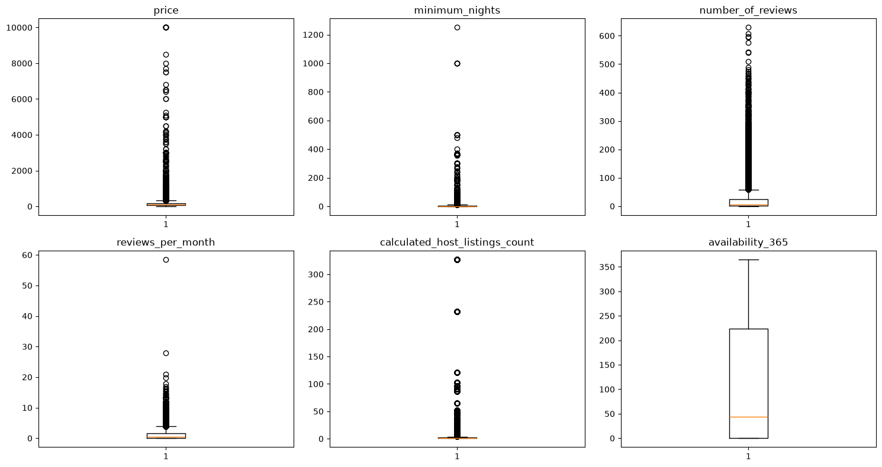
Outliers: real, not wrong
Box plots and the IQR rule across all six measured columns.
Flagged by IQR
price
2,936
minimum_nights
6,466
number_of_reviews
6,021
reviews_per_month
3,207
host_listings_count
6,895
availability_365
0
Only minimum_nights was capped. The rest are genuine listings — New York really does contain $10,000 penthouses.
Notes:
Every column except availability carries heavy outliers. But an outlier is not the same as an error. A ten thousand dollar penthouse is a real listing. A host with 327 properties is a real business. I kept all of them and capped only minimum_nights, because that was the one where the value was logically impossible rather than merely extreme.

Slide 6
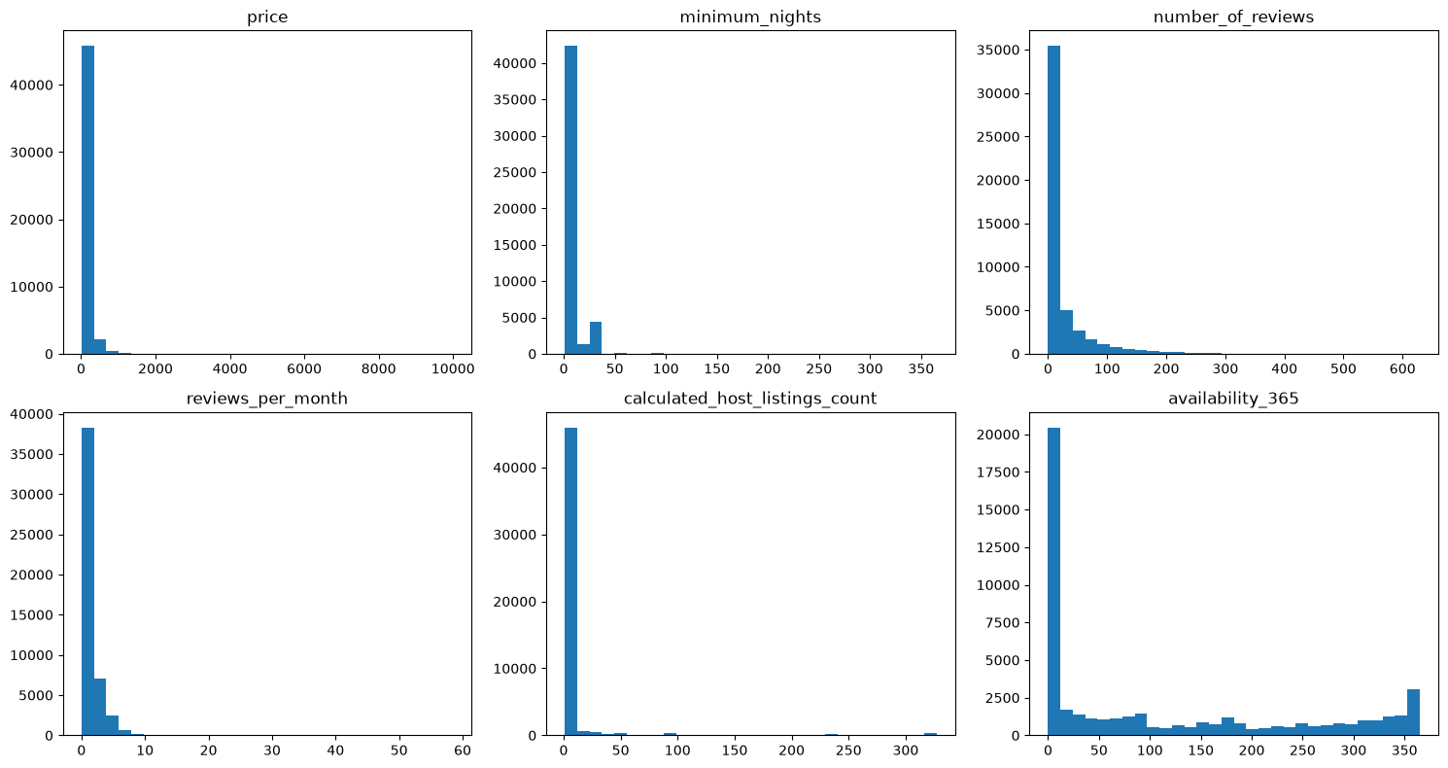
Everything is skewed right
For all six columns the mean sits above the median — a long tail of expensive, busy, professionalised listings.
$152.45
mean price — pulled up by the tail
$105
median price — what a typical New York listing actually costs
availability_365 is the exception: bimodal, clustering at 0 and at 365. Listings are either permanently open or effectively dormant.
Notes:
Every distribution leans right. That gap between the mean of 152 and the median of 105 is the whole story — quoting the average price overstates what a normal guest pays by nearly fifty dollars. The interesting exception is availability, which is bimodal: listings cluster at zero days and at 365. Hosts are either fully committed or basically inactive.

Slide 7
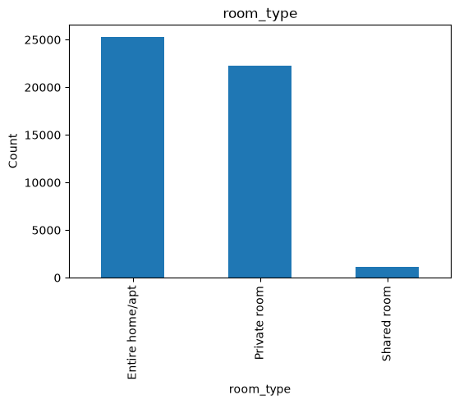
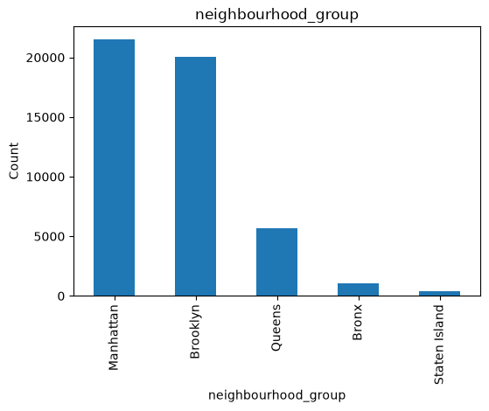
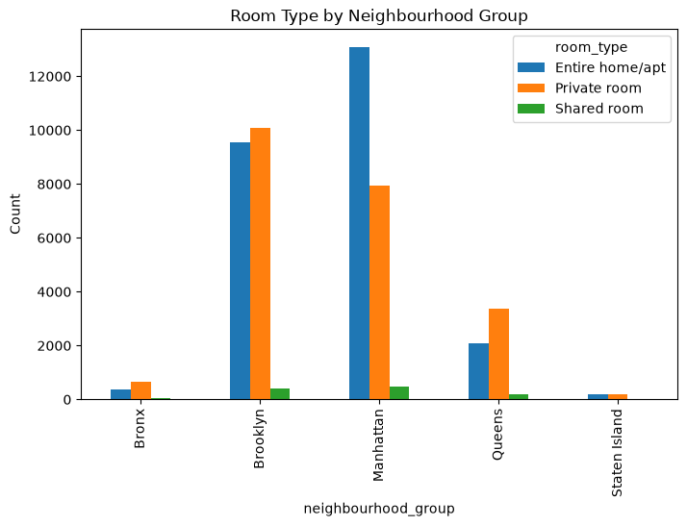
The market is concentrated
Two room types and two boroughs account for the overwhelming majority of supply.
Entire 51.97% · Private 45.68% · Shared 2.35%
Manhattan 44.19% · Brooklyn 41.21%
Room type split within each borough
Manhattan and Brooklyn hold 85% of all listings, and shared rooms are barely 2% of supply. Any model trained on these columns inherits that imbalance — the minority classes have too few examples to learn from.
Notes:
Both categorical columns are badly imbalanced. Entire homes and private rooms split the market almost evenly, while shared rooms are a rounding error at 2%. Geographically it's worse — Manhattan and Brooklyn together are 85% of supply, Staten Island is under 1%. The third chart shows these interact: Manhattan skews toward entire homes, the outer boroughs toward private rooms.

Slide 8
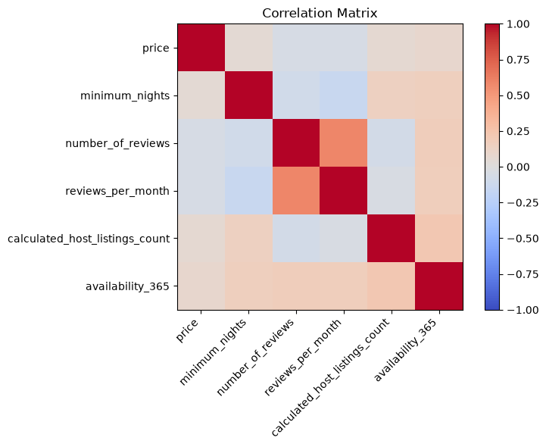
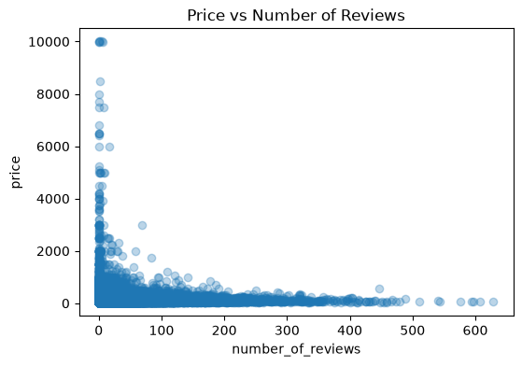
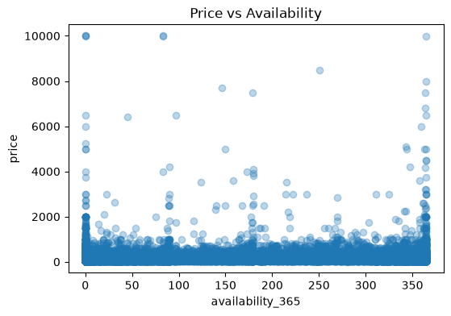
Price ignores the numbers
No numeric feature correlates with price above 0.08 — the drivers are categorical.
Correlation matrix
Price vs number of reviews
Price vs availability
Booking activity and host behaviour tell you almost nothing about price. Where the listing is, and what kind of space it is, tell you almost everything.
Notes:
This was the most interesting finding for me. I expected review volume or availability to move with price. They don't — every correlation with price is under 0.08 in absolute terms, which is effectively nothing. The scatter plots confirm it visually: no structure at all. Price in this market is not explained by how busy a listing is. It's explained by location and room type.

Slide 9
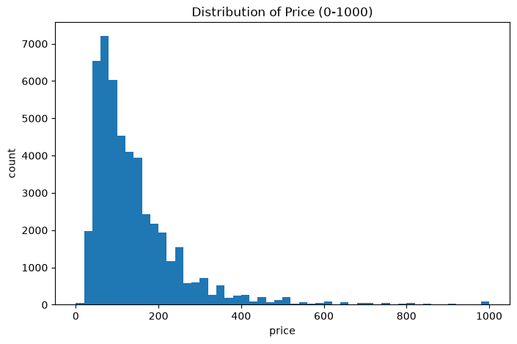
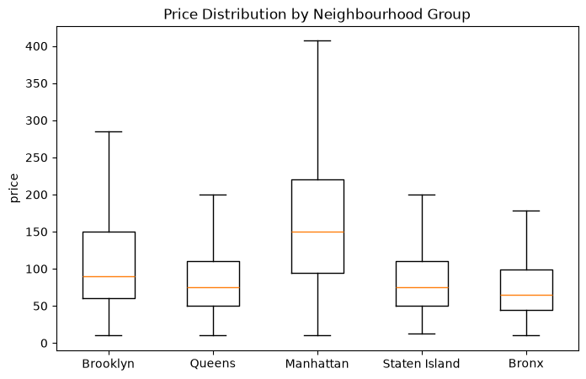
Where the money is
Price capped at $1,000 in the histogram so the luxury tail doesn't flatten the shape.
Most listings sit under $200, with a long right tail
Manhattan: highest median and the widest spread
Manhattan $196 · Brooklyn $125 · Staten Island $115 · Queens $100 · Bronx $88
Notes:
On the left, the price distribution — I capped the axis at a thousand dollars, otherwise a handful of ten-thousand-dollar listings compress everything else into a single bar. Most of the market is under two hundred. On the right, the same prices split by borough. Manhattan has both the highest median and the widest spread; the Bronx averages 88 dollars against Manhattan's 196.

Slide 10
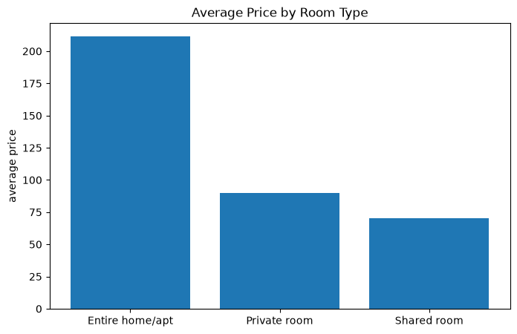
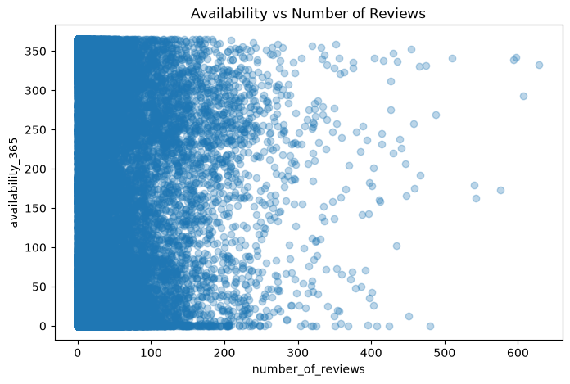
What guests pay a premium for
Room type is the single sharpest price divide in the dataset.
Entire home $211 · Private $90 · Shared $71
Reviews and availability move independently
An entire home costs roughly 2.4x a private room and 3x a shared room — the price of not sharing a front door.
Notes:
Room type produces the sharpest divide in the data. An entire home averages 211 dollars, a private room 90, a shared room 71. Guests pay roughly two and a half times over for not sharing the space. The right hand chart is a negative result but a useful one — number of reviews and availability are unrelated, so a busy listing is not a more open one.

Slide 11
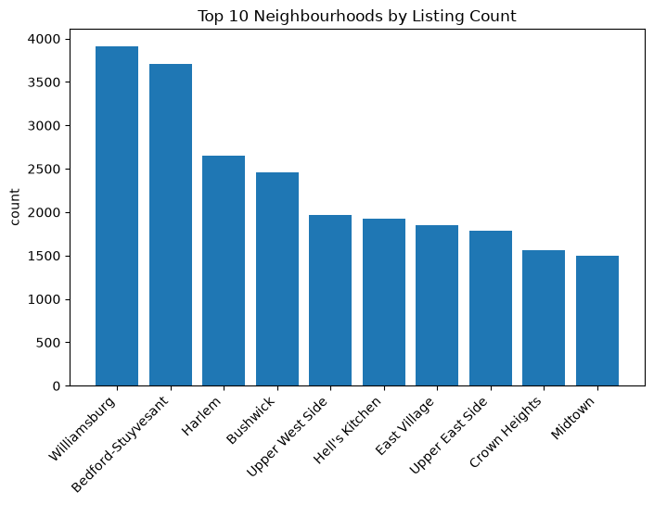
Supply clusters in a handful of places
221 neighbourhoods exist. Ten of them carry a disproportionate share of the market.
Why this matters
Williamsburg and Bedford-Stuyvesant alone dominate Brooklyn's supply.
neighbourhood is high-cardinality and heavily imbalanced — one-hot encoding it would create 221 mostly-empty columns.
Most of the 221 neighbourhoods carry too few listings to support a reliable per-neighbourhood price estimate.
Grouping the long tail, or falling back to borough, is the practical fix.
Notes:
The dataset has 221 neighbourhoods, but listings pile into a small number of them — Williamsburg and Bedford-Stuyvesant at the top. This matters practically: it's a high-cardinality imbalanced feature, so most neighbourhoods have too few listings to estimate a price from, and you'd want to group the long tail or fall back to borough.

Slide 12
What the data says
Six of the ten insights in the notebook.
01
02
03
Location beats everything
Privacy is the product
The average price is misleading
Manhattan averages $196 a night — double Brooklyn, more than double every other borough.
An entire home costs 2.4x a private room. Guests are buying exclusivity, not extra space.
Mean $152 against median $105. Quoting the mean overstates the typical stay by nearly a third.
04
05
06
Activity doesn't set price
A fifth of listings are invisible
Professional hosts have arrived
Every numeric correlation with price is under 0.08. Booking behaviour is not a pricing signal.
20.3% have never been reviewed — a trust gap new hosts cannot close on their own.
Sonder runs 327 listings and Blueground 232, while the median host runs exactly one.
Notes:
Pulling it together. Location and room type set the price. The average is misleading and the median is the honest number. Activity metrics are not a pricing signal at all. And two structural findings: a fifth of listings have never been reviewed, and professional operators running hundreds of units now sit alongside the median host who runs exactly one.

Slide 13
What I'd do about it
Five recommendations, each tied directly to a finding above.
1
Price on location and room type
Build host pricing guidance from borough and room type. Activity metrics add nothing — leaving them out makes the tool simpler and no less accurate.
2
Give new listings a way in
A verified-host badge or new-listing surface would let the 20% with no reviews compete before organic reviews arrive.
3
Ship a real pause button
Hosts already fake one with 500-night minimums. A native snooze toggle would clean the data and better serve the host.
4
Recruit outside the core two
Staten Island and the Bronx are barely represented. Targeted host acquisition there diversifies inventory and reduces dependence on Manhattan.
5
Flag duplicates at creation
217 near-duplicates slipped past an exact-match check. A soft warning at listing time keeps inventory counts honest.
Notes:
Five recommendations, each traceable to a specific finding. The pricing tool drops the features that don't predict. The badge addresses the review gap. The pause toggle fixes a behaviour the data caught hosts improvising. Host acquisition addresses the geographic imbalance. And duplicate flagging closes the gap that let 217 rows through.

Slide 14
WHAT I TOOK AWAY
EDA is the argument,
not the output.
Hardest problem
Most critical judgement
Do differently
The 217 near-duplicates. There was no shared key to group on, so I had to define what "the same listing" means before I could find them.
Not deleting the absurd minimum_nights values. Reading the listing names showed hosts using the field as a pause button — that is a finding, not dirt.
Run the duplicate check before the missing-value audit, so every percentage is measured once, on the final row set.
Thank you · Khalid Al Dosari
Notes:
Three reflections. The duplicates were hardest because there was no key — I had to decide what 'the same listing' means. The judgement I'm most pleased with was not deleting the impossible minimum_nights values, because reading the listing names turned them from dirt into a finding about host behaviour. And I'd reorder the workflow: dedupe first, then audit missing values, so the percentages are measured once. Thank you — happy to take questions.

